Slide 1
Clinical Web Interface
Team 5 • COMP 175 Project Part 2

Slide 2
Team 5 progress
Kali hosts our Flask dashboard; Ubuntu holds synthetic records.
Four persona logins use real Ubuntu accounts through read-only SSH.
An operator login manages only the Team 5 app.
Component checks show an allowed read, a denied read, and six passing tests.

Slide 3
Working component demo — Nov 5
Flask dashboard runs on Kali with five real command buttons
Persona login checks Ubuntu records through SSH
Allowed read succeeds; root-only record is denied
Next: connect to Team 4 RBAC on the shared class network
AI: Codex helped build and test this component

Slide 4
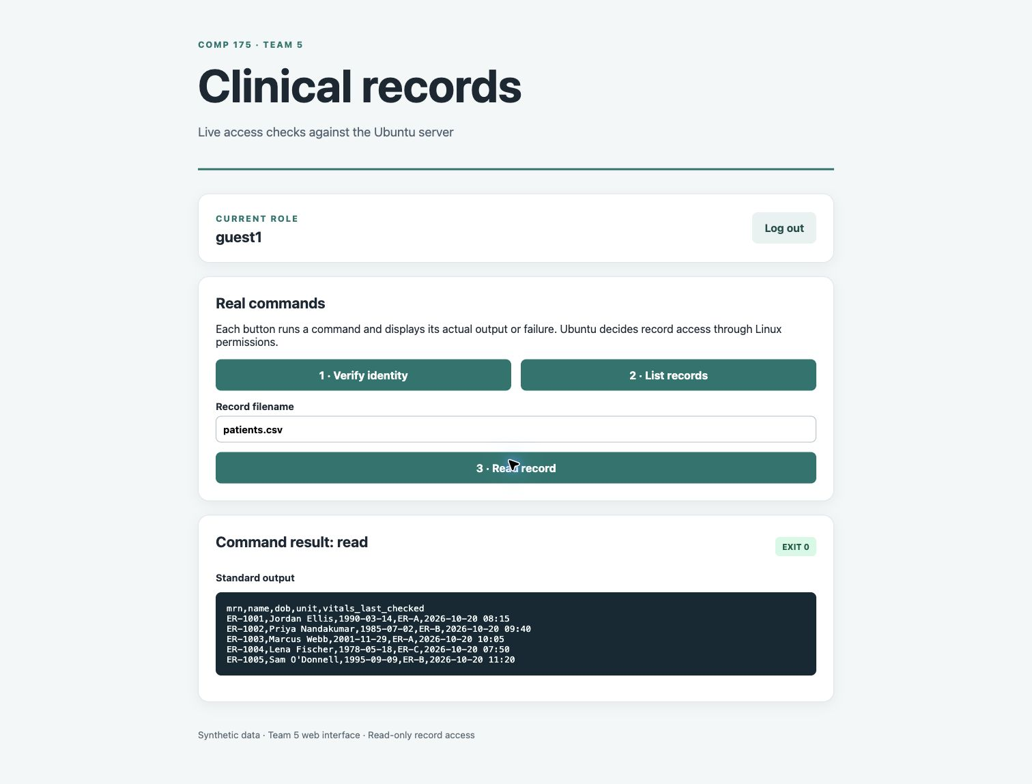
Live component evidence

Slide 5
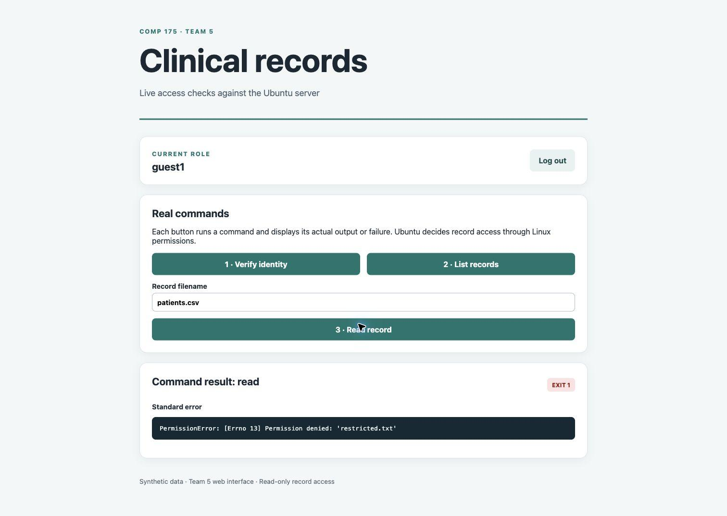
Ubuntu permission denied
Notes:
Component evidence from our isolated VM pair. The root-only restricted.txt is a Team 5 test fixture, not Team 4 RBAC.

Slide 6
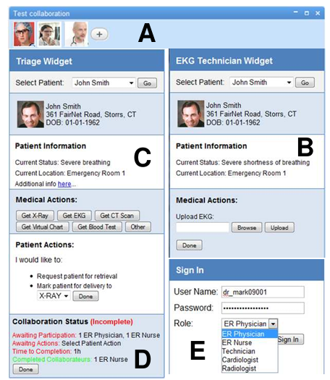
Next steps
Use Team 1's assigned class IPs and verify the network link.
With Team 4, connect our read-only gateway to their Ubuntu VM.
Repeat allowed and denied reads against Team 4's permissions.
Agree with Teams 1 and 4 on log, traffic, and account views.
Notes:
Design reference only: the clinical interface image comes from the instructor-shared paper, not our working app (https://pmc.ncbi.nlm.nih.gov/articles/PMC3041320/pdf/amia-2010_sympproc_0036.pdf). Team 5 owns the web interface. Team 1 handles network monitoring; Team 4 owns clinical accounts, groups, and record permissions.

Slide 7

Current blockers
Verify class IPs and the USB Ethernet link.
Test Team 4's Ubuntu permissions over SSH.
Get GitHub write access; our push returned 403.
Notes:
Status as of 5 November 2026. The Team 5 component works on our isolated VM pair. The adapter image illustrates a possible connection to the class switch; the live class link has not been verified. GitHub refused write access for Elvin0016, so the Team 5 commit remains local on Kali.

